Slide 1


Hii, Iam Siddhika
Welcome to Power BI Series
Part -33

Slide 2

Today Content
We focus only on the most used and important Dax Functions
I’m soo Excited.
Are you ready guys?
Meet DAX
COMMON FUNCTION CATEGORIES
4. FILTER FUNCTIONS (FEW MORE)
ALL ALLEXCEPT ALLSELECTED

Slide 3

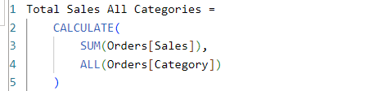

ALL
The ALL function in DAX is used to remove filters from one or more columns or tables. It can be used to clear filters to perform calculations without any filtering context, allowing you to return a complete dataset or a specific column without any filters applied.
Check this
Syntax
ALL( [<table> | <column>[, <column>[, <column>[,…]]]] )
Suppose you have a Orders table with columns "Category" and "Sales ". You want to create a measure that calculates the total sales amount across all categories, ignoring any filters on the "Category" column.
Example
This dax calculates the total sales amount from the "Orders" table, ignoring any filters applied to the "Category" column. This means it provides the total sales across all categories, even if a user has applied filters to view sales for specific categories.

Slide 4
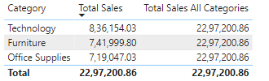

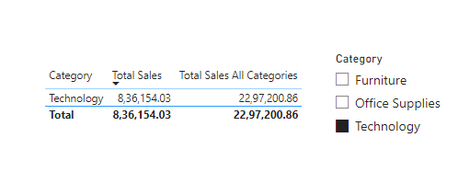

Visual Example for better understanding
Understood?
Imagine you have a report where users can filter sales by category. Even if the user selects only "Technology" in the report, the Total Sales All Categories measure will still calculate the total sales amount for all categories.
In this example, even though the user has filtered the report to show only the "Technology" category, the "Total Sales All Categories" measure calculates the total sales amount across all categories, ignoring the filter applied to the "Category" column.

Slide 5
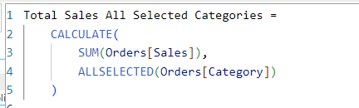
ALLSELECTED
The ALLSELECTED function returns all the values in a column or all the rows in a table that are currently selected, ignoring only the direct filters on that specific column or table but keeping all other filters applied.
Check this
Syntax
ALLSELECTED([<tableName> | <columnName>[,
<columnName>[, <columnName>[,…]]]] )
^{Example} We want to create a measure that calculates the total sales amount based on the current user selections, ignoring direct filters on the
Category column but considering all other filters applied .
The measure "Total Sales All Selected Categories" calculates the total sales amount across all categories currently selected, while respecting the other filters applied in the report.

Slide 6
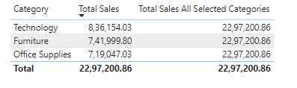
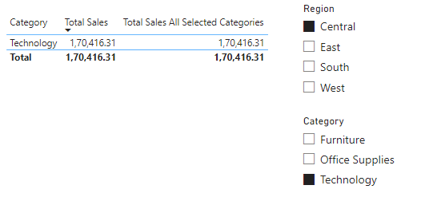
Visual Example for better understanding
Understood?
Imagine you have a report where users can filter sales by category. Even if the user selects only “Technology” category, the "Total Sales All Selected Categories" measure will calculate the total sales amount across these selected categories, while respecting other filters applied in the report.
In this example, if the user selects "Technology" categories, the "Total Sales All Selected tegories" measure will calculate the total sales amount across these selected categories , while
respecting other filters “ East” Region.

Slide 7

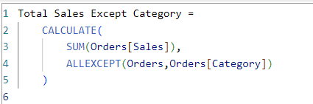
ALLEXCEPT
The ALLEXCEPT function in DAX is used to remove filters from all columns in a table except for the specified columns. This allows you to clear all filters except those on certain columns, which can be useful when you want to preserve specific filter contexts while ignoring others.
check this?
Syntax
ALLEXCEPT(<table>,<column>[,<column>[,…]])
Example
Suppose you have a Orders table with columns "Category". You want to create a measure that calculates the total sales amount across all products, while keeping the filter on the "Category" column.
The measure "Total Sales Except Category" calculates the total sales amount across all Coulmns, while keeping the filter on the "Category" column.

Slide 8
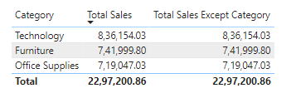
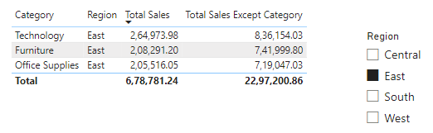
Visual Example for better understanding
Understood?
Imagine you have a report where users can filter sales by category and Region. Even if the user selects "East region, the "Total Sales Except Category" measure will ignores the filter to the category column
In this example, even though the user has filtered the report to show only the "East" Region, the "Total Sales Except Category" measure calculates the total sales amount across all categories.

Slide 9
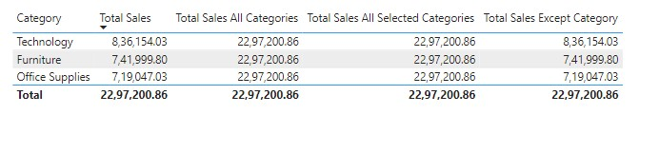
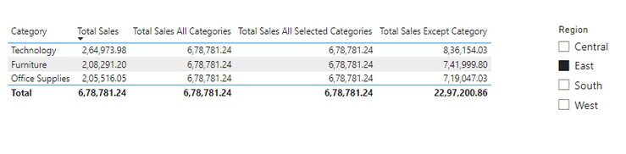
Understanding difference of ALL,ALLSELECTED , ALLEXCEPT
Before filter
Understood?
After filter

Slide 10


Thank you for joining me today to learn about Part -33 of Power BI!
Remember, Learning DAX is key to unlocking the full potential of Power BI for insightful reporting and visualization.
Stay tuned for more insights and tips on Power BI in our next Series.
Follow
Siddhika Shah

